Slide 1

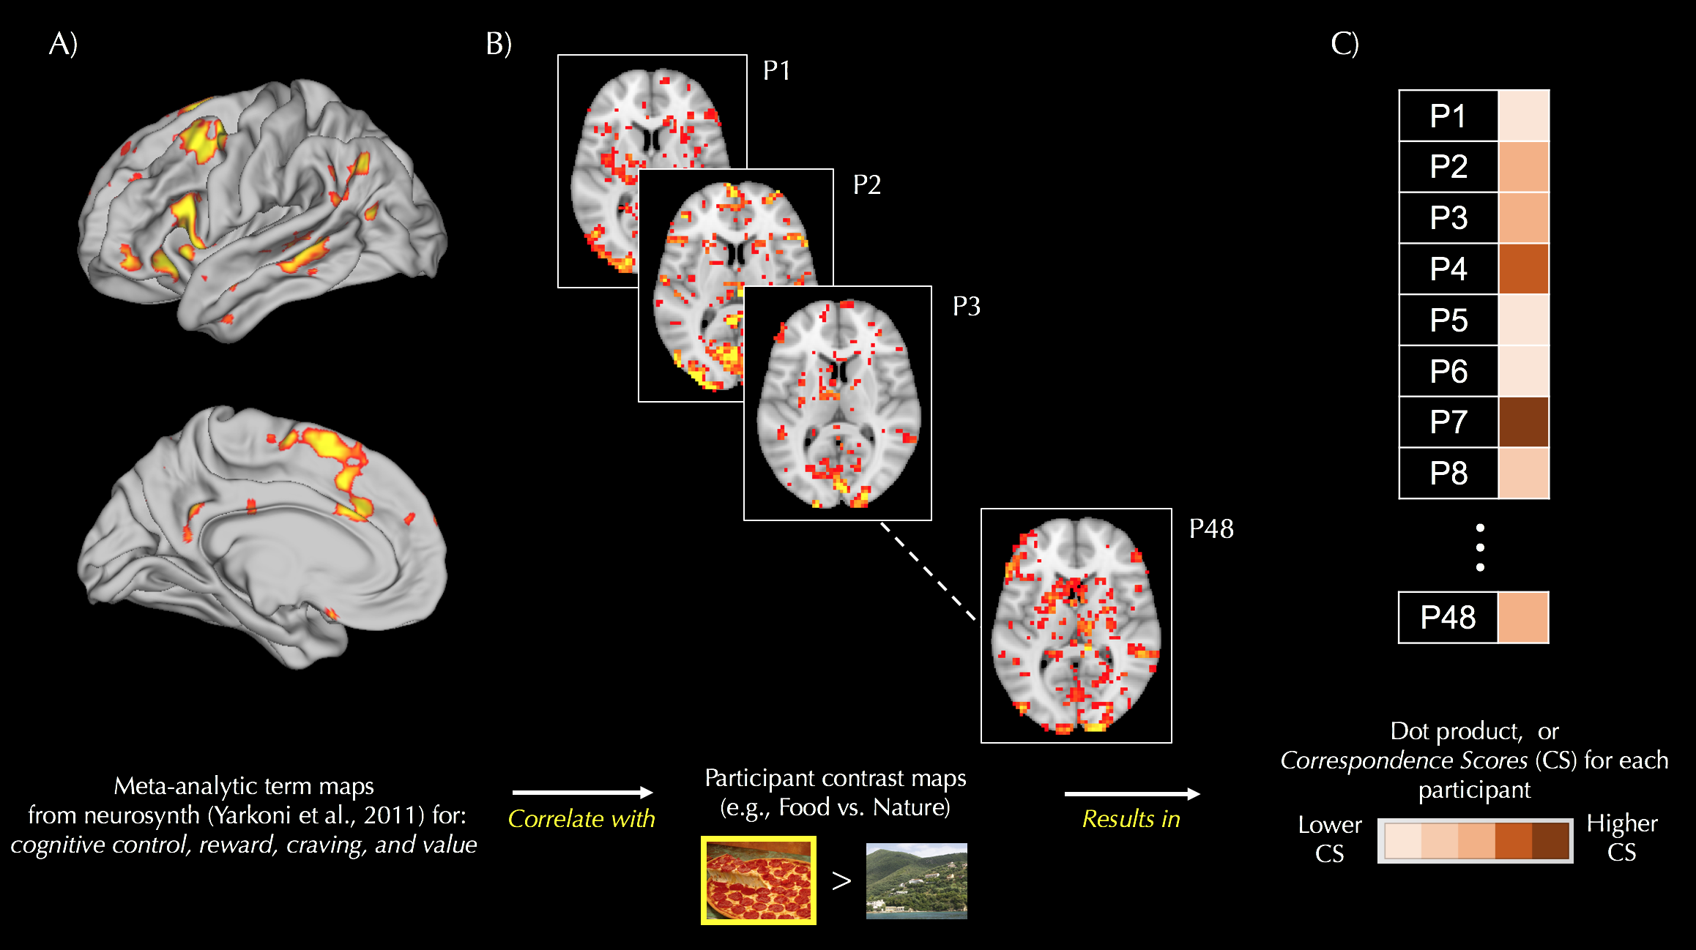
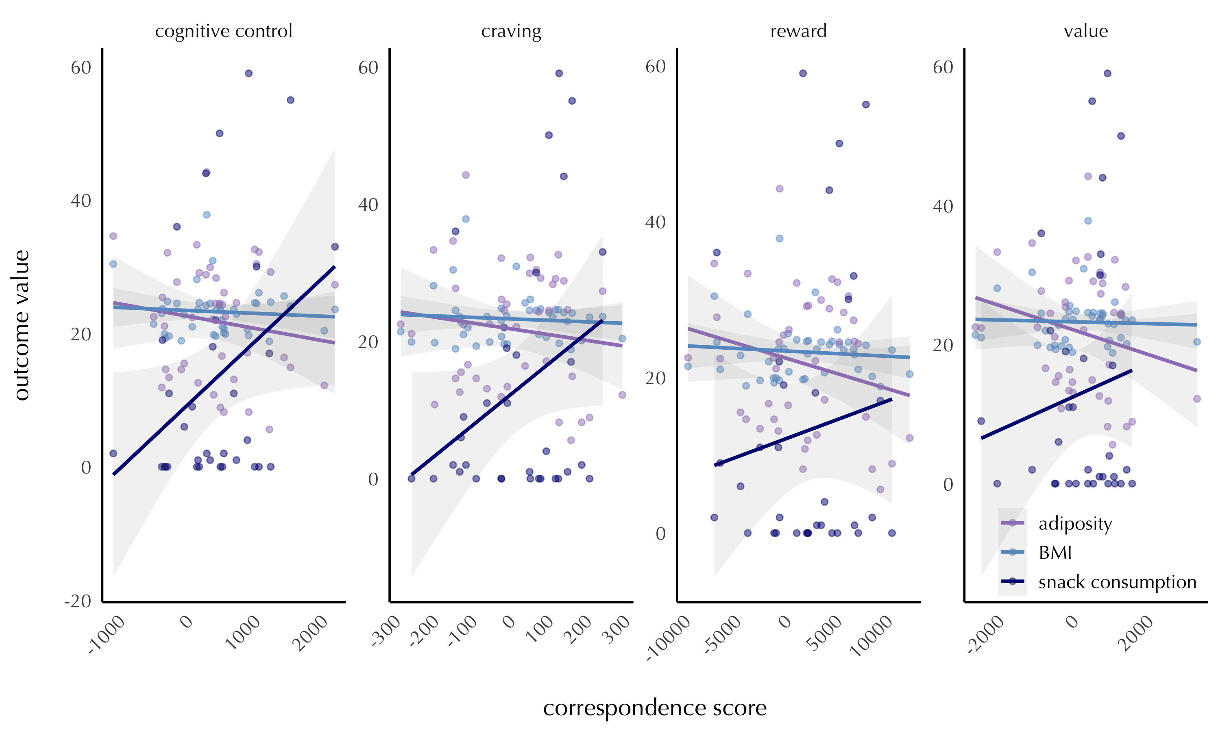
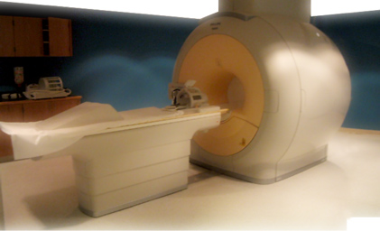
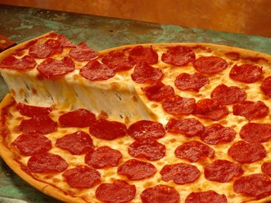

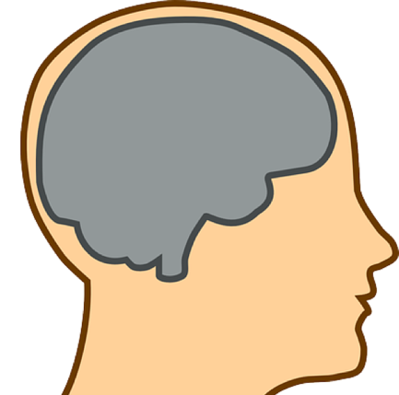
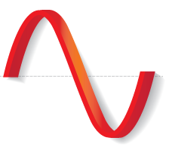
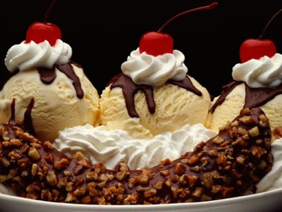

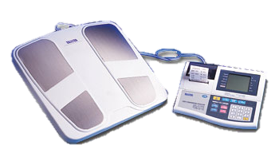
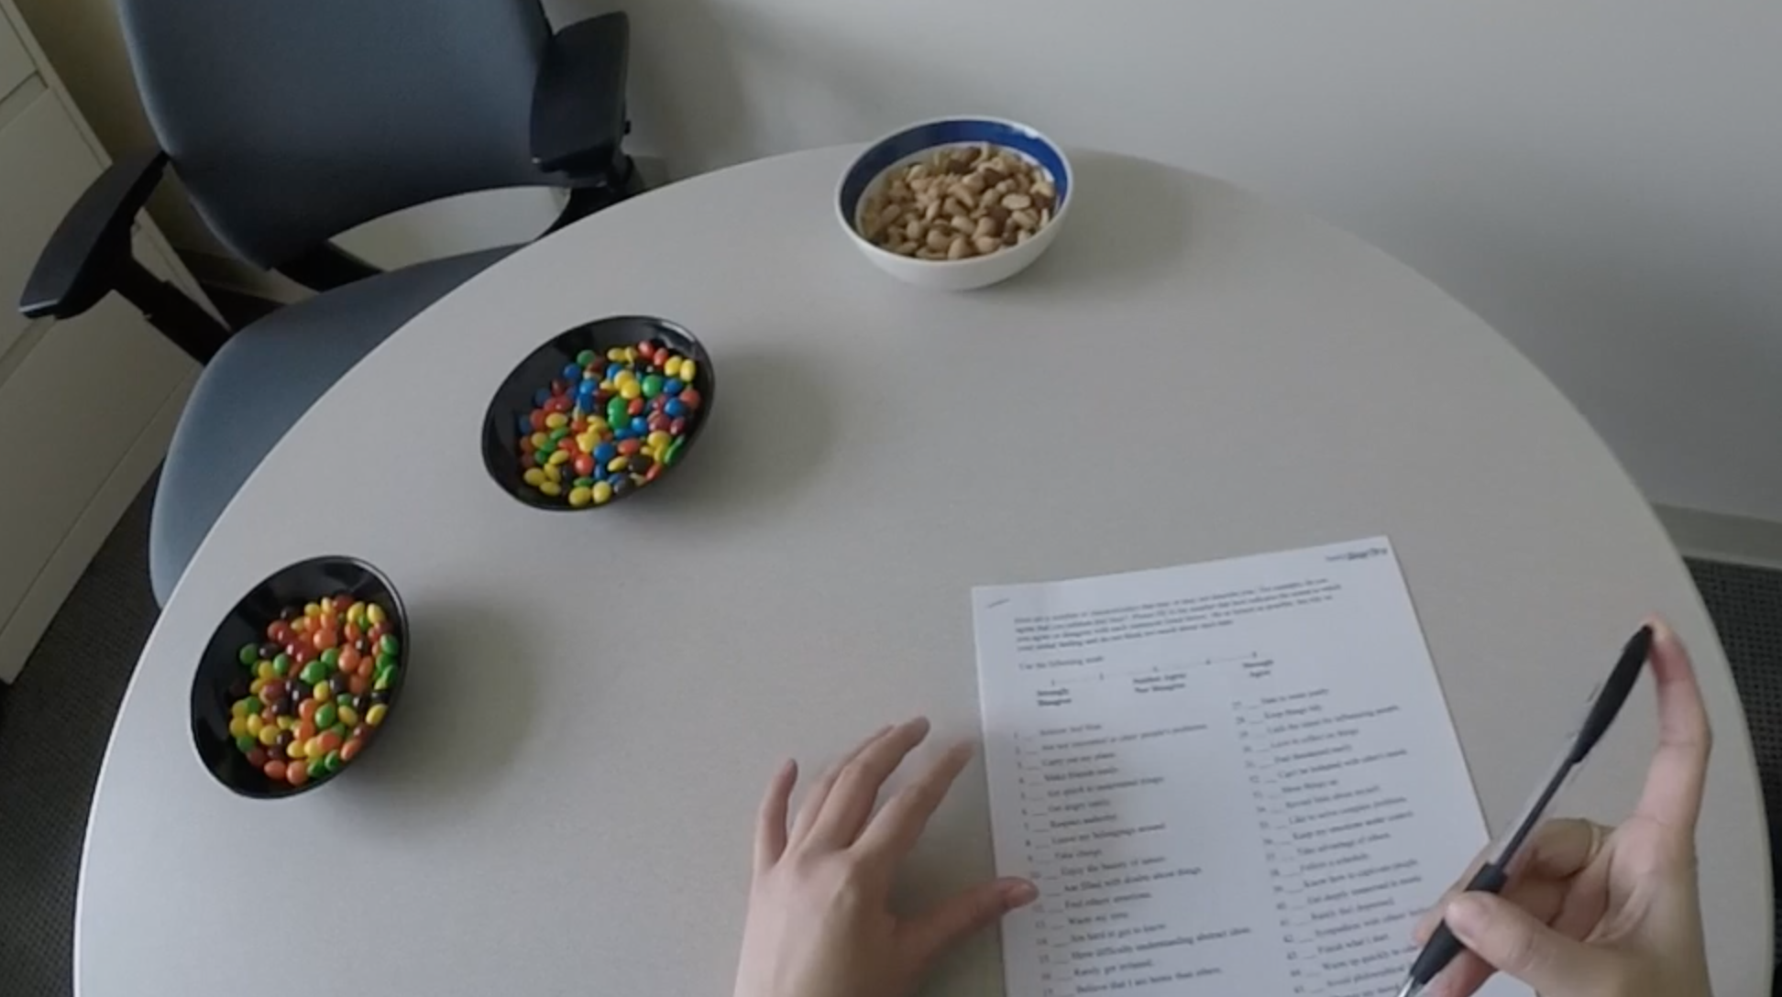

Neural correlates of spontaneous food cue reactivity, regulation, and valuation
Richard B. Lopez¹, Danielle Cosme², & Elliot T. Berkman²
¹Department of Psychological Sciences, Rice University; ²Department of Psychology, University of Oregon
XXXX
WHOLE-BRAIN PATTERN EXPRESSION
CONCLUSIONS
BACKGROUND
An emerging goal of self-regulation research is to characterize how individuals effectively manage their thoughts, feelings, and behaviors in naturalistic settings, outside the laboratory. A major obstacle to accurately predicting real-world outcomes is the discrepancy between the ways in which self-regulation is often measured in the lab and how it is actually experienced and exerted in situ.
Only recently have researchers begun to assess spontaneous processes in more naturalistic, uninstructed contexts and related engagement of these processes to real world self-regulatory behaviors (e.g., Berkman & Falk, 2013; Lopez et al., 2014). A recent model by Giuliani and colleagues (2018) has suggested that multiple psychological processes representing reactivity, regulation, and valuation, a should all be taken into account to better characterize people’s eating behaviors (Giuliani, Merchant, Cosme, & Berkman, 2018).
Accordingly, we conducted a study to determine whether spontaneous brain responses, during exposure to high-caloric food images during an fMRI scanning session, reliably index psychological processes related to reactivity, regulation, and valuation and are associated with individual differences in ad libitum eating behavior and body composition (i.e., body mass index and adiposity).
Preliminary results suggest that whole-brain pattern expression of putative psychological processes during cue exposure, namely cognitive control, may indeed better characterize actual eating behavior and body composition—when compared with traditional univariate analyses of specific regions of interest. One speculation about the positive association between cognitive control pattern expression and snack eating is that the higher activity/pattern expression may reflect inefficient inhibitory control processes.
FUTURE DIRECTIONS
Although several of our hypotheses from planned, primary analyses were not supported by the data, analyses and results from secondary analyses are forthcoming. One such analysis will be to examine patterns of functional connectivity between multiple brain systems associated with reactivity, regulation, and valuation, respectively.
For example, we will test whether valuation of high-calorie foods—as indexed by ventral medial prefrontal cortex (VMPFC) activity—modulates connectivity patterns between reward (e.g., ventral striatum) and control regions (e.g., dorsolateral prefrontal cortex), such that higher VMPFC activity is associated with lower functional coupling between reward and control areas, resulting in greater snack eating and/or higher BMI/adiposity.
Lastly, an exploratory follow-up analysis informed by the present results is to examine specificity of whole-brain patterns to appetizing, high-caloric foods generally speaking, versus patterns during exposure to specific kinds of foods (e.g., snacks vs. desserts vs. meals). If such specificity is observed, then perhaps it would better predict participants’ snack eating.
Adapted from Shahane, Lopez, & Denny (2018). CABN.
INITIAL RESULTS FROM PRE-REGISTERED* ANALYSES
Correlations between all correspondence scores and outcome measures
METHOD
Participants
Forty-eight undergraduate volunteers (33 Females; M_{age}=19.6, SD_{age}=1.48)
Procedure & Measures
Cue reactivity task in fMRI scanner (to operationalize brain features)
References
Berkman, E. T., & Falk, E. B. (2013). Beyond brain mapping: Using neural measures to predict real-world outcomes. Current Directions in Psychological Science, 22(1), 45–50.
Giuliani, N. R., Merchant, J. S., Cosme, D., & Berkman, E. T. (2018). Neural predictors of eating behavior and dietary change. Annals of the New York Academy of Sciences, 1428, 208–220
Lopez, R. B., Hofmann, W., Wagner, D. D., Kelley, W. M., & Heatherton, T. F. (2014). Neural predictors of giving in to temptation in daily life. Psychological Science, 25(7), 1337-44.
Shahane, A.D., Lopez, R.B., & Denny, B.T. (2018). Implicit reappraisal as an emotional buffer: Reappraisal-related neural activity moderates the relationship between inattention and perceived stress during exposure to negative stimuli. Cognitive, Affective, & Behavioral Neuroscience.
Yarkoni, T., Poldrack, R. A., Nichols, T. E., Van Essen, D. C., & Wager, T. D. (2011). Large-scale automated synthesis of human functional neuroimaging data. Nature Methods, 8(8), 665.
+
Self-regulatory outcome measures
Model comparison (with cognitive control CS) AIC
Assessment of body composition (i.e., BMI and adiposity)
Ad libitum eating of snack foods (M&Ms, Skittles, and Peanuts)
snack consumption ~ 1 287.5
snack consumption ~ 1 + cognitive control CS 285.2
snack consumption ~ 1 + cognitive control CS + ROI composite 287.2
snack consumption ~ 1 + cognitive control CS + ROI composite 286.3
 | B | SE | t | p
intercept | 8.877 | 3.619 | 2.453 | .020
cognitive control | 0.010 | 0.005 | 2.077 | .046
*
You can find the preregistration for this study and other associated files
at the following OSF link: https://osf.io/ua5yr/
This work was supported by Grant R01DA022582 from the National Institute on Drug Abuse.

